Slide 1
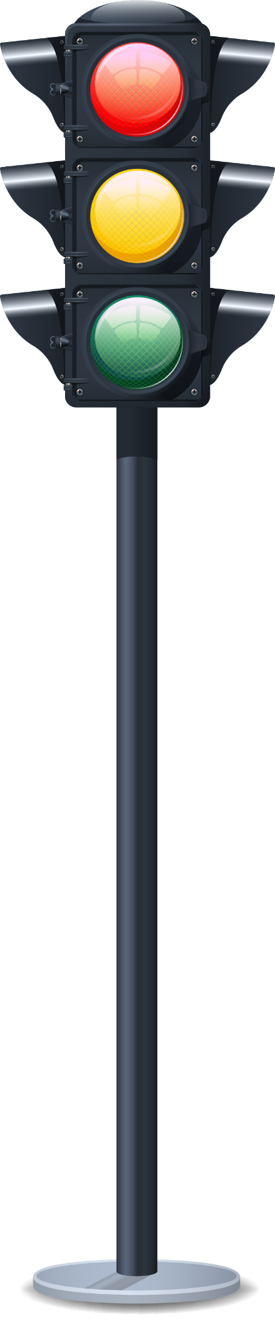
Red-Light Violation Detection

Slide 2
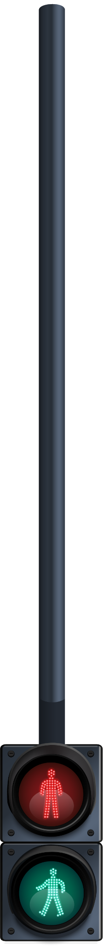
Table of contents
01
02
03
04
05
Interoduction
Dataset
Methodology
Results
Conclusion

Slide 3
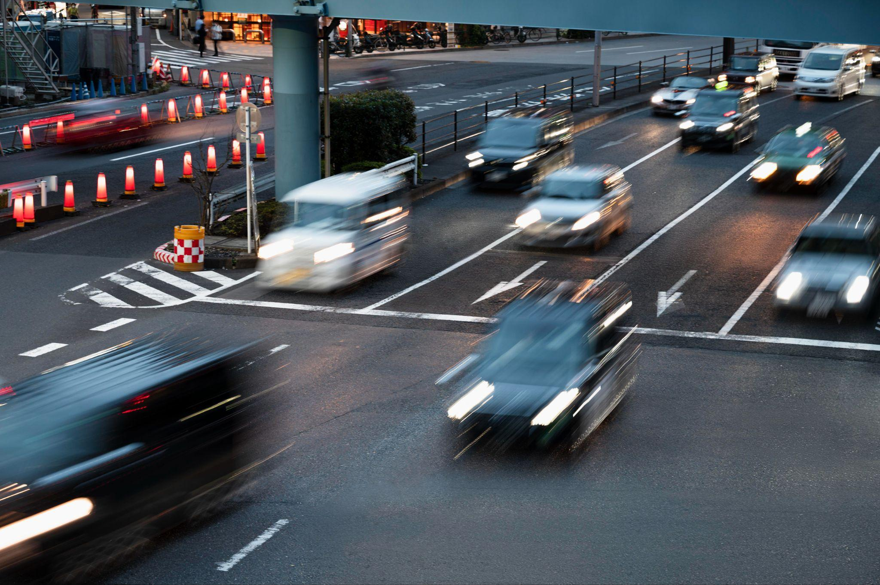
Introduction
The goal of our project is to address the problem of red light violations as it frequently contributes to road accidents or traffic jams. With the implementation of this real time detection system, we seek to minimize these violations, improve the safety of the roads, and eliminate traffic congestion at critical intersections which in the long run will lead to a more uninterrupted and safer ride throughout the nation.

Slide 4
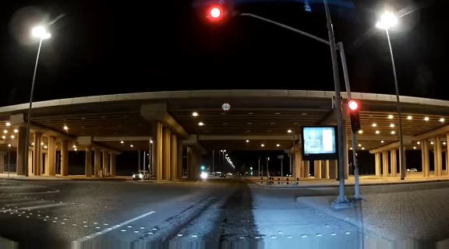
Dataset

Slide 5
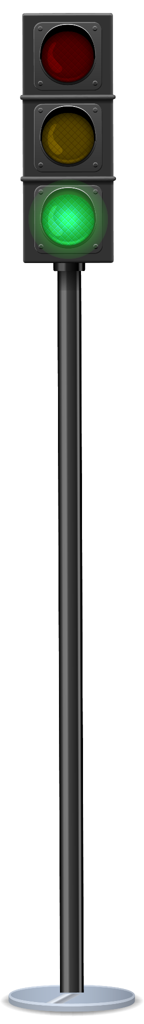
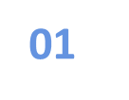
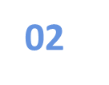
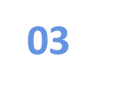

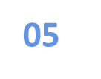

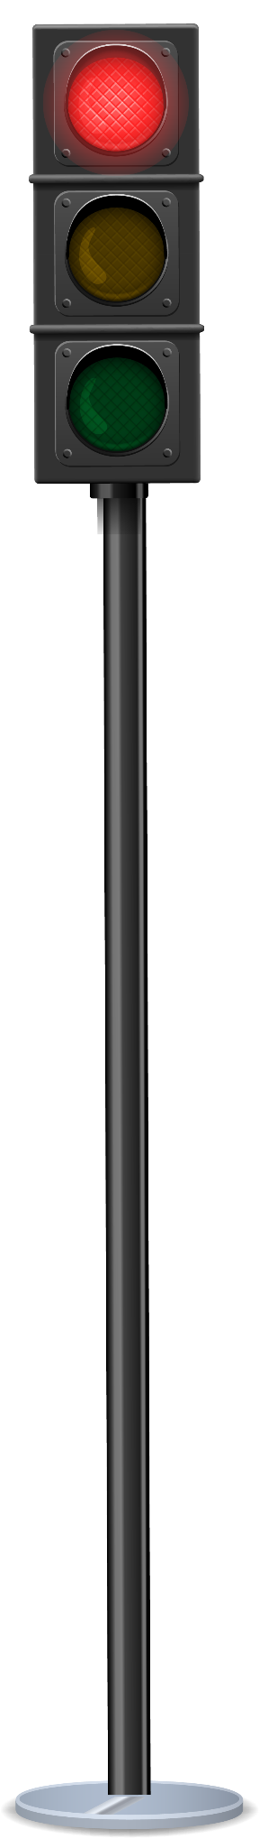
Methodology
Collicting Videos
Visualize
Split the Dataset
Apply YOLO Model
Model Evaluation
Save

Slide 6
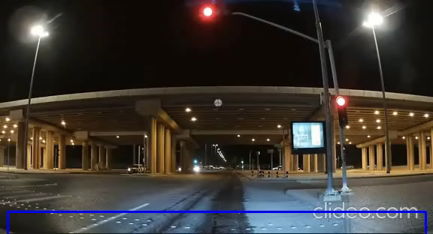
Results

Slide 7
Conclusion
To sum up, we collected data, developed a YOLO model, and trained it to produce the best results; By ensuring safer roads and enhanced traffic flow, this integrated approach helps to improve the effectiveness of the country's transportation network.

Slide 8
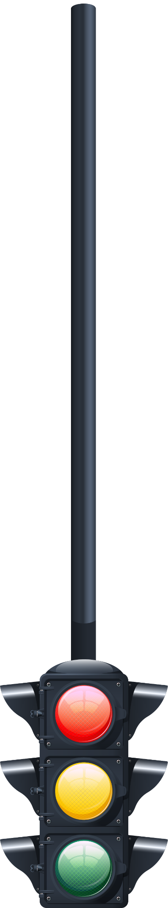
Team Work
Rana al-harsan
Dana Almistdadi
Retaj Alanazii

Slide 9

Do you have any questions?

